Slide 1
Progress update Ryan Cardenas
18.06.20

Slide 2
Contents
Overview (my job)
What are Pipelines?
Pipelines developed:
QC
Germline
Somatic
Projects in progress
Future work

Slide 3


Overview – my job
receive collaborator
samples
process samples:
QC
Alignments etc
Results:
Write up report

Slide 4
Mapping and QC
Processing
Post Processing
Mapping and QC
Variant calling / Transcript count
Filtering

Slide 5
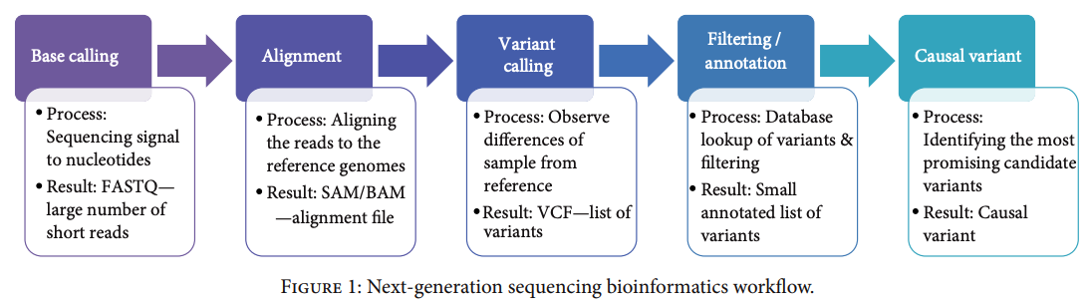
What is a pipeline?
QC

Slide 6
Quality Control Pipeline:
TrimGalore
cgpMAP
sort
hybrid stats
PCR removal
multiQC: here
Somalier
Relatedness
Somalier
Ancestry
verifyBAM_ID
Variant Analysis
230
next pipeline

Slide 7
Quality Control Pipeline:
Samples
Config
Cholesteatoma
S0102-P
S0108
S0501
S0502
…
+
GRCh38
Bait bed
Index primers
…
TrimGalore
Disease
Abnormality of drum skin migration
locally invasive
capable of causing bone destruction
inflammation
cgpMAP
sort
hybrid stats
Samples
- Patients from UK
(most Norwich)
Total 20 samples
9 Families
(min 2 per fam)
- All affected
multiQC: he
re
PCR removal
Somalier
Relatedness
Somalier
Relatedness
Somalier
Ancestry
Somalier
Ancestry
contamination
contamination?
verifyBAM_ID
verifyBAM_ID
Variant Analysis
contamination
next pipeline

Slide 8
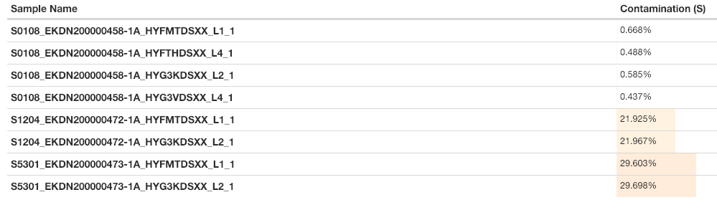
Cholesteatoma: contamination example
VerifyBAMID
Very high levels of contamination

Slide 9
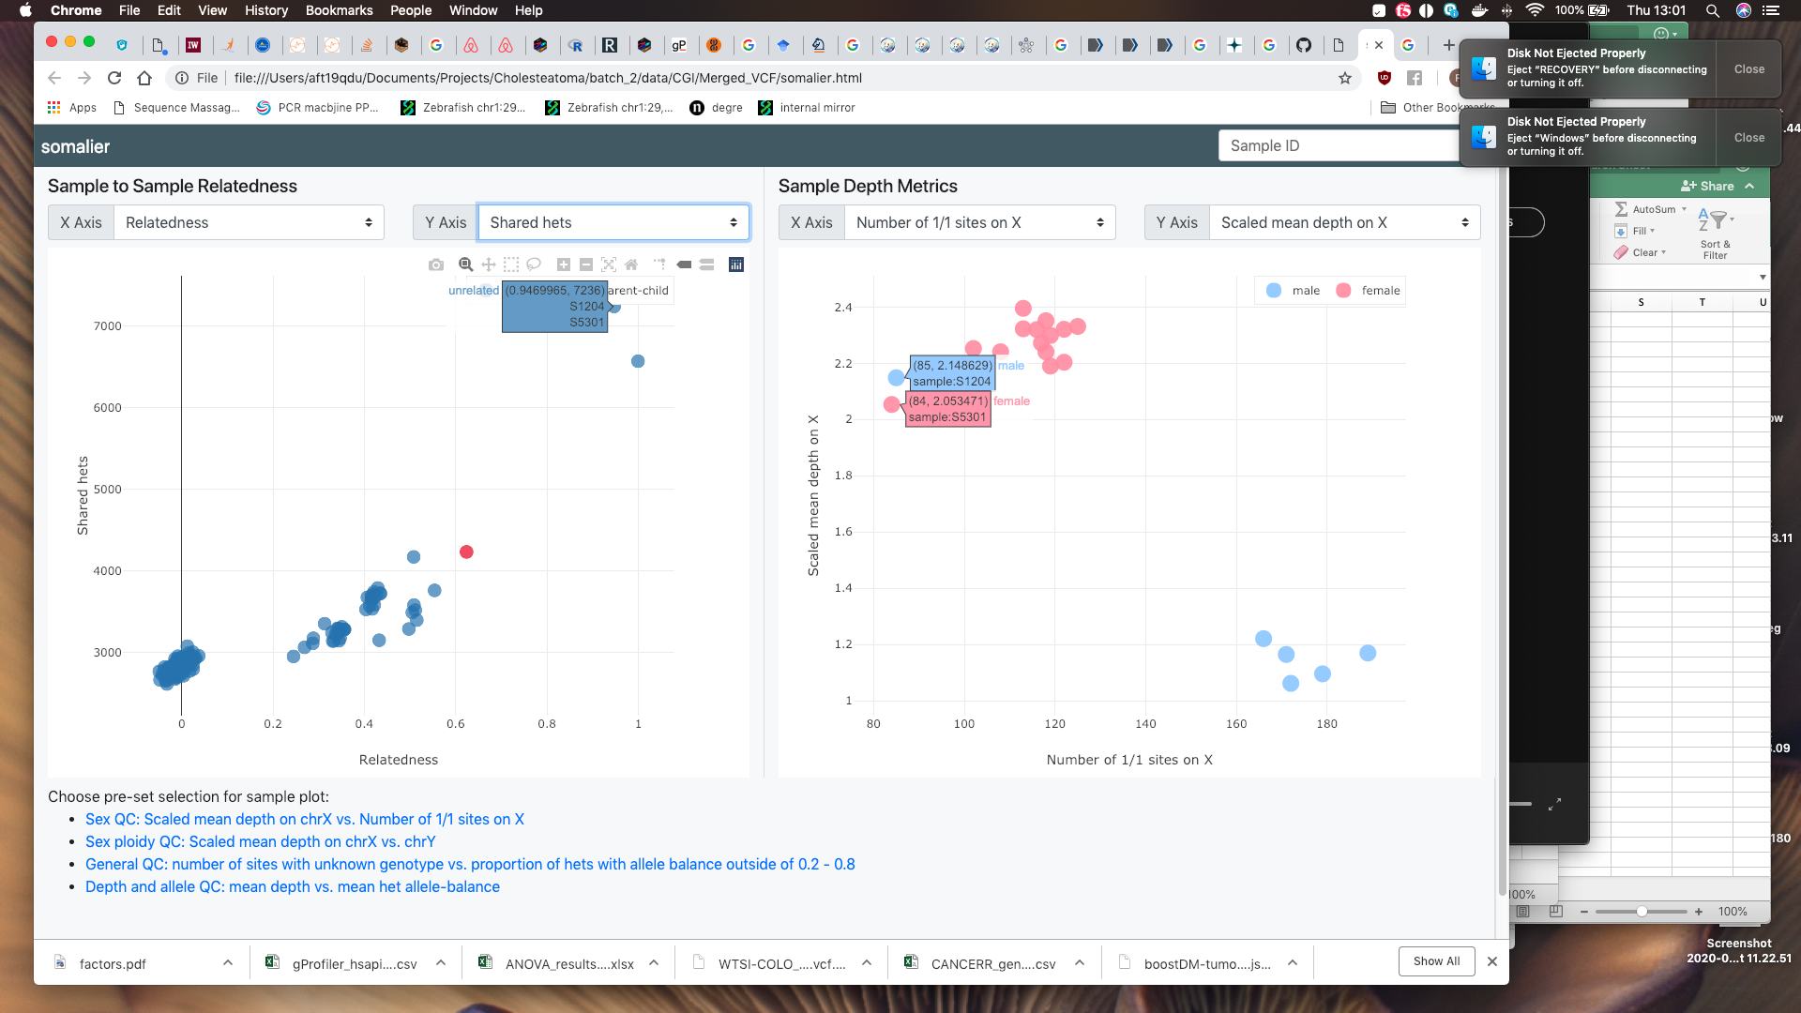
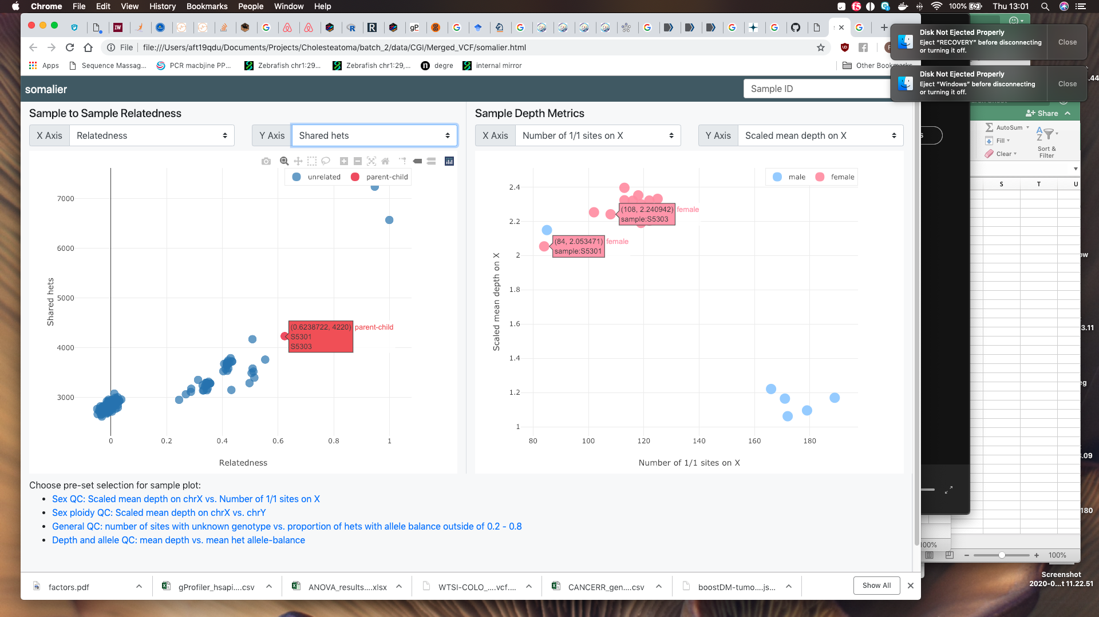
Example of contamination
Relatedness plot
Uses shared variants (homs / hets) to calculated relatedness scores
Samples from the same family have higher relatedness scores
Can also be used for Tumour / Normal matched samples.
This analysis shows two samples from different families having very high relatedness.

Slide 10
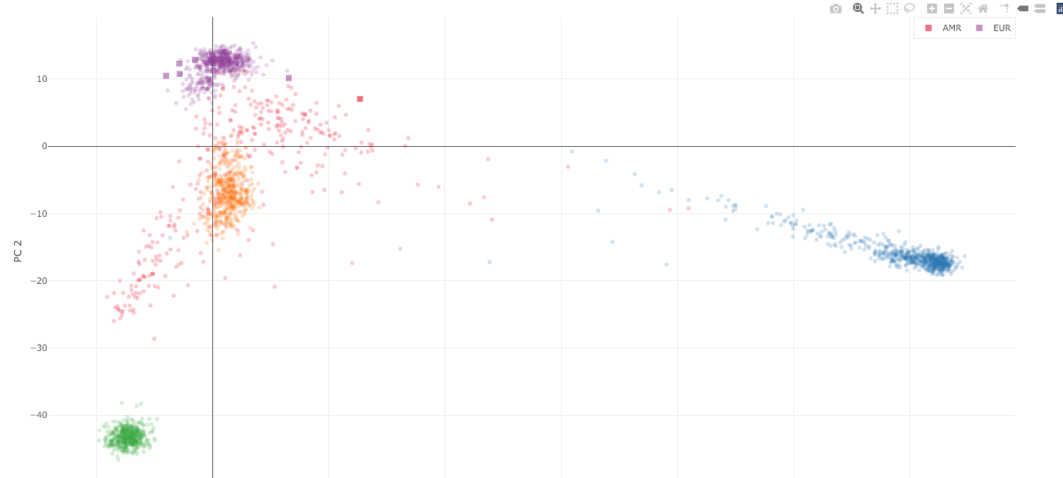
Example: Ancestry
link

Slide 11
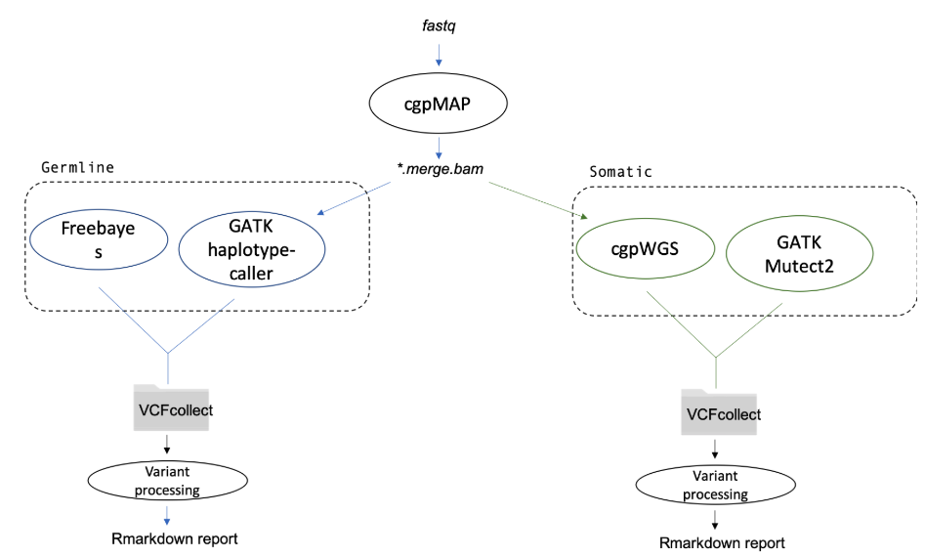
Variant Analysis Pipelines:

Slide 12
Freebayes pipeline
GATK pipeline
baseCalibrator
Freebayes
haplotypeCaller
filter variants
CNN score variants
index
Filter variants
index
overlap
Ensembl: VEP
Maftools
plots.. etc
400

Slide 13
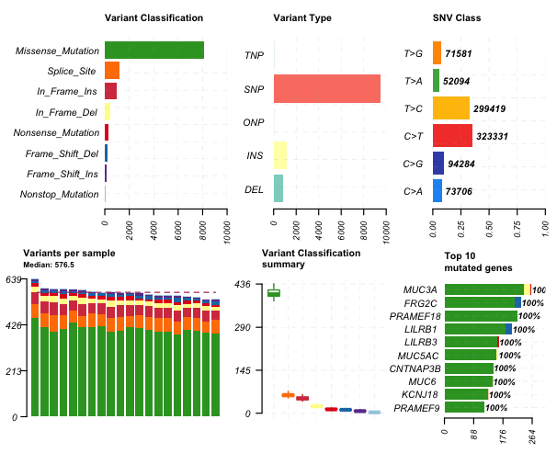
MAF Tools: summary plot

Slide 14
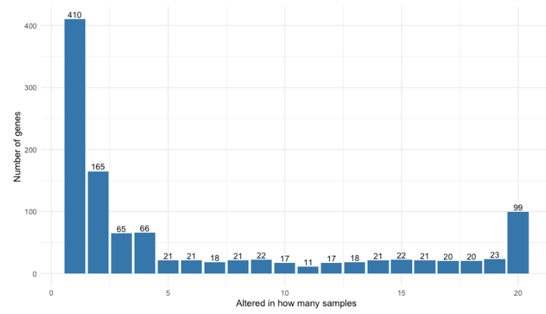
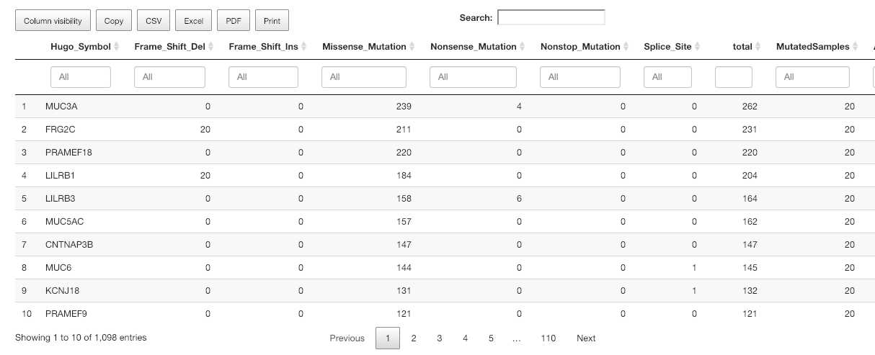
Number of mutated genes per sample:

Slide 15
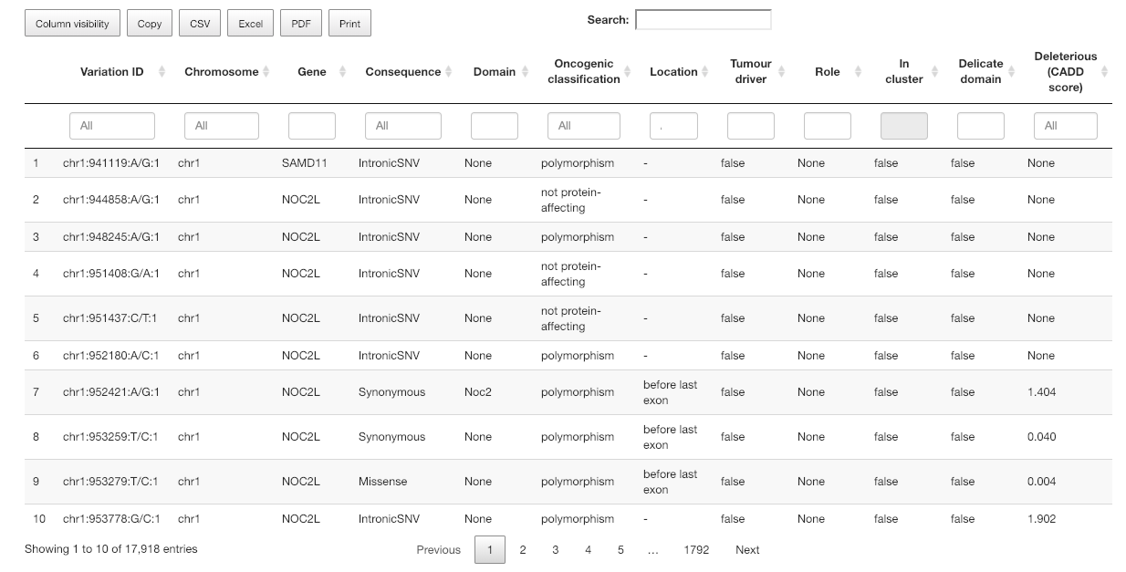
Predicted deleteriousness of variants:
using Ensembl’s VEP toolbox (SIFT, Polyphen and Cancer genome interpreter)

Slide 16
source | term_name | term_id | term_size | query_size | intersection_size | effective_domain_size | intersections
1 | GO:BP | digestion | GO:0007586 | 139 | 217 | 11 | 17906 | CAPN9,PBLD,MUC6,WNK1,NOD2,ABCG5,ABCG8,TYMP,PRSS1,OPRK1,PRSS3
2 | GO:CC | DNA recombinase complex | GO:0097519 | 2 | 223 | 2 | 18856 | RAG1,RAG2
3 | KEGG | ABC transporters | KEGG:02010 | 45 | 91 | 5 | 7788 | ABCG5,ABCG8,ABCB5,ABCA13,ABCB1
4 | REAC | Dectin-2 family | REAC:R-HSA-5621480 | 26 | 129 | 5 | 10594 | MUC6,PLCG2,MUC16,MUC3A,MUC12
5 | REAC | Defective GALNT12 causes colorectal cancer 1 (CRCS1) | REAC:R-HSA-5083636 | 16 | 129 | 4 | 10594 | MUC6,MUC16,MUC3A,MUC12
6 | REAC | Defective GALNT3 causes familial hyperphosphatemic tumoral calcinosis (HFTC) | REAC:R-HSA-5083625 | 16 | 129 | 4 | 10594 | MUC6,MUC16,MUC3A,MUC12
7 | REAC | Defective C1GALT1C1 causes Tn polyagglutination syndrome (TNPS) | REAC:R-HSA-5083632 | 17 | 129 | 4 | 10594 | MUC6,MUC16,MUC3A,MUC12
8 | CORUM | RAG1-RAG2 tetramer complex | CORUM:5384 | 2 | 45 | 2 | 3629 | RAG1,RAG2
9 | CORUM | ABCG5-ABCG8 complex | CORUM:7263 | 2 | 45 | 2 | 3629 | ABCG5,ABCG8

Slide 17
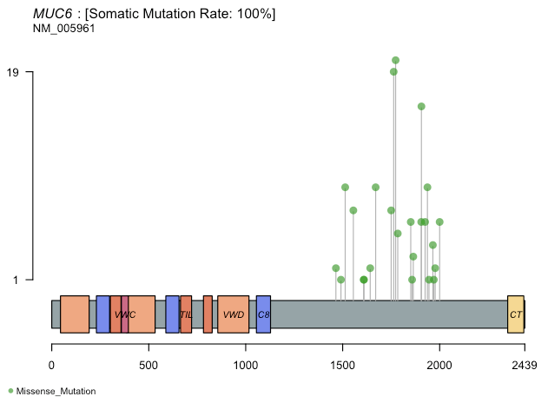

Slide 18
Future work:
Polish report-generating side of variant pipeline
Create more pipelines:
RNA-seq
somatic/germline structural variants
Create website for clients to access (link)

Slide 19
Thanks!

Slide 20
BCRE Genomics

